Slide 1
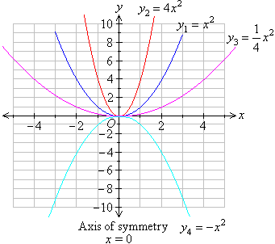
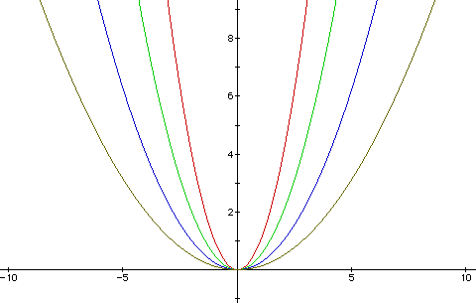
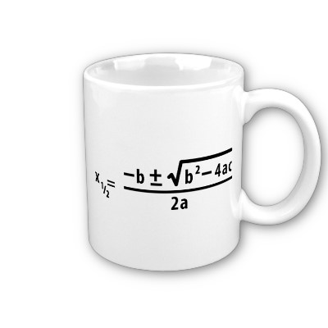
Quadratic Functions

Slide 2
Introduction
This Chapter focuses on Quadratic Equations
We will be looking at Drawing and Sketching graphs of these
We are also going to be solving them using various methods
As with Chapter 1, some of this material will have been covered at GCSE level

Slide 3
Teachings for Exercise 2A

Slide 4
Quadratic Functions
Plotting Graphs
You need to be able to accurately plot graphs of Quadratic Functions.
The general form of a Quadratic Equation is;
y = ax² + bx + c
Where a, b and c are constants and a ≠ 0.
This can sometimes be written as;
f(x) = ax² + bx + c
→ f(x) means ‘the function of x’
2A

Slide 5
Quadratic Functions
y = x² – 3x - 4
Plotting Graphs
You need to be able to accurately plot graphs of Quadratic Functions.
x
-2
-1
0
1
2
3
4
5
x²
4
1
0
1
4
9
16
25
3x
-6
-3
0
3
6
9
12
15
x² -3x
10
4
0
-2
-2
0
4
10
Example
y
6
0
-4
-6
-6
-4
0
6
a) Draw the graph with equation y = x² – 3x – 4 for values of x from -2 to +5
BE CAREFUL! Subtract what is in the ‘3x’ box, from the ‘x²’ box.
b) Write down the minimum value of y at this point
And subtract 4 at the end…
c) Label the line of symmetry
2A

Slide 6
Quadratic Functions
y = x² – 3x - 4
Plotting Graphs
You need to be able to accurately plot graphs of Quadratic Functions.
x | -2 | -1 | 0 | 1 | 2 | 3 | 4 | 5
y | 6 | 0 | -4 | -6 | -6 | -4 | 0 | 6
y = x² – 3x - 4
Example
a) Draw the graph with equation y = x² – 3x – 4 for values of x from -2 to +5
1.5
b) Write down the minimum value of y
-1
4
The minimum value occurs at the x value halfway between 4 and -1
c) Label the line of symmetry
Substitute this value into the equation:
y = x² – 3x - 4
y = 1.5² – (3 x 1.5) - 4
y = -6.25
2A

Slide 7
Quadratic Functions
y = x² – 3x - 4
Plotting Graphs
You need to be able to accurately plot graphs of Quadratic Functions.
x | -2 | -1 | 0 | 1 | 2 | 3 | 4 | 5
y | 6 | 0 | -4 | -6 | -6 | -4 | 0 | 6
x = 1.5
y = x² – 3x - 4
Example
a) Draw the graph with equation y = x² – 3x – 4 for values of x from -2 to +5
b) Write down the minimum value of y
y = -6.25
c) Label the line of symmetry
2A

Slide 8
Teachings for Exercise 2B

Slide 9
Quadratic Functions
Solving by Factorisation
You need to be able to solve Quadratic Equations by factorising them.
A Quadratic Equation will have 0, 1 or 2 solutions, known as ‘roots’
If there is 1 solution it is known as a ‘repeated root’
Example
Solve the equation…
a)
Subtract 9x
Factorise
Either ‘x’ or ‘x-9’ must be equal to 0
2B

Slide 10
Quadratic Functions
Solving by Factorisation
You need to be able to solve Quadratic Equations by factorising them.
A Quadratic Equation will have 0, 1 or 2 solutions, known as ‘roots’
If there is 1 solution it is known as a ‘repeated root’
Example
Solve the equation…
b)
Factorise
2B

Slide 11
Quadratic Functions
Solving by Factorisation
You need to be able to solve Quadratic Equations by factorising them.
A Quadratic Equation will have 0, 1 or 2 solutions, known as ‘roots’
If there is 1 solution it is known as a ‘repeated root’
Example
Solve the equation…
c)
Factorise
Factorising this is slightly different.
There must be a ‘2x’ at the start of a bracket
The numbers in the brackets must still multiply to give ‘-5’
The number in the second bracket will be doubled when they are expanded though, so the numbers must add to give ‘-9’ WHEN ONE HAS BEEN DOUBLED
Using -5 and +1
They multiply to give -5
If we double the -5, they add to give -9
So the -5 goes opposite the ‘2x’ term
2B

Slide 12
Quadratic Functions
Solving by Factorisation
You need to be able to solve Quadratic Equations by factorising them.
A Quadratic Equation will have 0, 1 or 2 solutions, known as ‘roots’
If there is 1 solution it is known as a ‘repeated root’
Example
Solve the equation…
d)
Factorise
Factorising this is even more difficult
The brackets could start with 6x and x, or 2x and 3x (either of these would give the 6x² needed)
So the numbers must multiply to give -5
And add to give 13 when either;
  One is made 6 times bigger
  One is made twice as big, and the other 3 times bigger
Using 3x and 2x at the starts of the brackets
And -1 and +5 inside the brackets…
They multiply to give -5
They will add to give 13 if the +5 is tripled, and the -1 is doubled
So +5 goes opposite the 3x, and -1 opposite the 2x
2B

Slide 13
Quadratic Functions
Solving by Factorisation
You need to be able to solve Quadratic Equations by factorising them.
A Quadratic Equation will have 0, 1 or 2 solutions, known as ‘roots’
If there is 1 solution it is known as a ‘repeated root’
Example
Solve the equation…
e)
Subtract 2 Subtract 3x
Factorise
2B

Slide 14
Quadratic Functions
Solving by Factorisation
You need to be able to solve Quadratic Equations by factorising them.
A Quadratic Equation will have 0, 1 or 2 solutions, known as ‘roots’
If there is 1 solution it is known as a ‘repeated root’
Example
Solve the equation…
Square root both sides (2 possible answers!)
f)
2B

Slide 15
Quadratic Functions
Solving by Factorisation
You need to be able to solve Quadratic Equations by factorising them.
A Quadratic Equation will have 0, 1 or 2 solutions, known as ‘roots’
If there is 1 solution it is known as a ‘repeated root’
Example
Solve the equation…
Square root both sides (2 possible answers!)
g)
2B

Slide 16
Teachings for Exercise 2C

Slide 17
Quadratic Functions
Completing the Square
Quadratic Equations can be written in another form by ‘Completing the Square’
Example
Complete the square for the following expression…
a)
If we check by expanding our answer…
‘So ^{b}/₂ is half of the coefficient of x’
2C

Slide 18
Quadratic Functions
Completing the Square
Quadratic Equations can be written in another form by ‘Completing the Square’
Example
Complete the square for the following expression…
b)
‘So ^{b}/₂ is half of the coefficient of x’
2C

Slide 19
Quadratic Functions
Completing the Square
Quadratic Equations can be written in another form by ‘Completing the Square’
Example
Complete the square for the following expression…
c)
With Decimals
With Fractions
‘So ^{b}/₂ is half of the coefficient of x’
2C

Slide 20
Quadratic Functions
Completing the Square
Quadratic Equations can be written in another form by ‘Completing the Square’
Example
Complete the square for the following expression…
d)
Factorise first
Complete the square inside the bracket
You can work out the second bracket
‘So ^{b}/₂ is half of the coefficient of x’
You can also multiply it by the 2 outside
2C

Slide 21
Teachings for Exercise 2D

Slide 22
Quadratic Functions
Using Completing the Square
You can use the idea of completing the square to solve quadratic equations.
This is vital as it needs minimal calculations, and no calculator is needed when using surds. (The Core 1 exam is non-calculator)
Example
Solve the following equation by completing the square…
a)
Subtract 10
Complete the Square
Add 16
Square Root
Subtract 4
2D

Slide 23
Quadratic Functions
Example
Using Completing the Square
You can use the idea of completing the square to solve quadratic equations.
This is vital as it needs minimal calculations, and no calculator is needed when using surds. (The Core 1 exam is non-calculator)
Solve the following equation by completing the square…
b)
Divide by 2
Subtract ⁷/₂
Complete the square
Add 4
Square Root
Add 2
2D

Slide 24
Teachings for Exercise 2E

Slide 25
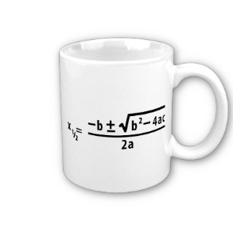
Quadratic Functions
The Quadratic Formula
You will have used the Quadratic Formula at GCSE level.
You can also use it at A-level for Quadratics where it is more difficult to complete the square.
We are going to see where this formula comes from (you do not need to know the proof!)
2E

Slide 26
Quadratic Functions
Top and bottom of 2nd fraction multiplied by 4a
The Quadratic Formula
Divide all by a
Combine the Right side
Subtract ^{c}/_{a}
Square Root
Complete the Square (Half of ^{b}/_{a} is ^{b}/_{2a})
Square Root top/bottom separately
Square the 2nd bracket
Subtract ^{b}/_{2a}
Add ^{b2}/_{4a2}
Combine the Right side
2E

Slide 27
Quadratic Functions
The Quadratic Formula
You need to be able to recognise when the formula is better to use.
Examples would be when the coefficient of x² is larger, or when the 3 parts cannot easily be divided by the same number.
Example
Solve 4x² – 3x – 2 = 0 by using the formula.
a = 4
b = -3
c = -2
2E

Slide 28
Teachings for Exercise 2F

Slide 29
Quadratic Functions
Sketching Graphs
You need to be able to sketch a Quadratic by working out key co-ordinates, and knowing what shape it should be.
y
y
y
x
x
x
y
y
y
x
x
x
b² – 4ac is known as the ‘discriminant’
→ Its value determines how many solutions the equation has
2F

Slide 30
Quadratic Functions
Example
Sketching Graphs
To sketch a graph, you need to work out;
1) Where it crosses the y-axis
2) Where (if anywhere) it crosses the x-axis
Then confirm its shape by looking at the value of a, as well as the discriminant (b² – 4ac)
Sketch the graph of the equation;
y = x² – 5x + 4
Where it crosses the y-axis
The graph will cross the y-axis where x=0, so sub this into the original equation.
(0,4)
(1,0)
(4,0)
Co-ordinate (0,4)
Where it crosses the x-axis
The graph will cross the x-axis where y=0, so sub this into the original equation.
Co-ordinates (1,0) and (4,0)
2F

Slide 31
Quadratic Functions
y
Sketching Graphs
To sketch a graph, you need to work out;
1) Where it crosses the y-axis
2) Where (if anywhere) it crosses the x-axis
Then confirm its shape by looking at the value of a, as well as the discriminant (b² – 4ac)
y = x² – 5x + 4
(0,4)
(1,0)
(4,0)
x
Confirmation → a > 0 so a ‘U’ shape
b² – 4ac
-5² – (4x1x4)
9
Greater than 0 so 2 solutions
2F

Slide 32

Quadratic Functions
Example
Sketching Graphs
You can also use the information on the discriminant to calculate unknown values.
You need to remember;
‘real roots’ → b² - 4ac > 0
‘equal roots’ → b² – 4ac = 0
‘no real roots’ → b² – 4ac < 0
Find the values of k for which;
x² + kx + 9 = 0
has equal roots.
Sub in a, b and c from the equation (b = k!)
Work out the bracket
Add 36
Square Root
2F

Slide 33
Summary
We have recapped solving a Quadratic Equation
We have learnt how to use ‘completing the square’
We have also solved questions on sketching graphs and using the ‘discriminant’

