Slide 1

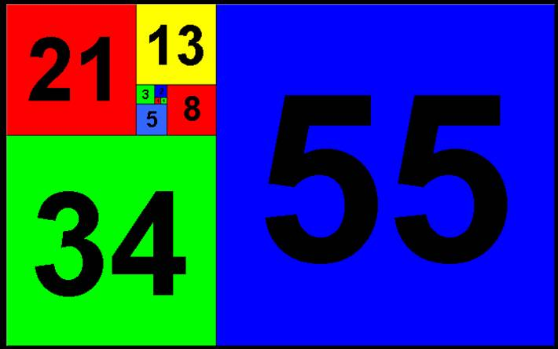
Sequences and Series

Slide 2
Introduction
This Chapter focuses on sequences and series
We will look at writing and using algebraic sequences
We will also be learning how to calculate the sum of a sequence

Slide 3
Teachings for Exercise 6B

Slide 4

Sequences and Series
The nth term
The nth term of a sequence is sometimes known as the ‘general term’.
You need to become familiar with the terminology of sequences in A-level maths.
Example 1
The nth term of a sequence is given by U_{n} = 3n – 1. Work out the 1st, 3rd and 19th terms.
1st
3rd
19th
6B

Slide 5
Sequences and Series
The nth term
The nth term of a sequence is sometimes known as the ‘general term’.
You need to become familiar with the terminology of sequences in A-level maths.
Example 3
The nth term of a sequence is given by:
Work out the 20th term.
6B

Slide 6
Sequences and Series
The nth term
The nth term of a sequence is sometimes known as the ‘general term’.
You need to become familiar with the terminology of sequences in A-level maths.
Example 3
Find the value of n for which the formula
has a value of 153.
U_{n} = 153
Add 2
Divide by 5
6B

Slide 7
Sequences and Series
The nth term
The nth term of a sequence is sometimes known as the ‘general term’.
You need to become familiar with the terminology of sequences in A-level maths.
Example 4
Find the value of n for which the formula
has a value of 72.
U_{n} = 72
Subtract 72
Factorise
2 possible solutions
But n has to be positive, so n = 12
6B

Slide 8
Sequences and Series
The nth term
The nth term of a sequence is sometimes known as the ‘general term’.
You need to become familiar with the terminology of sequences in A-level maths.
1) Form 2 equations using the information you have been given
2) Solve them simultaneously to find values for a and b
Example 5
A sequence is generated by the formula
Given that U₃ = 5 and U₈ = 20, find the values of a and b.
n = 3
n = 8
U₃ = 5
U₈ = 20
1)
2)
2) – 1)
6B

Slide 9
Teachings for Exercise 6C

Slide 10
Sequences and Series
Recurrence Relationships
When you have a rule to get from one term to the next, you can use a ‘recurrence relationship’
5, 8, 11, 14, 17
The rule could be described as ‘add 3 to the previous term’
It is important to remember that the sequences:
5, 8, 11, 14, 17
and
4, 7, 10, 13, 16
Will have the same recurrence relationship:
However, the first one has U₁ = 5 and the second has U₁ = 4
The next term
The current term
6C

Slide 11
Sequences and Series
Recurrence Relationships
When you have a rule to get from one term to the next, you can use a ‘recurrence relationship’
5, 8, 11, 14, 17
The rule could be described as ‘add 3 to the previous term’
Example 1
Find the first 5 terms of the following sequences:
a)
7, 11, 15, 19, 23
b)
5, 9, 13, 17, 21
c)
The next term
Next term
Current term
Previous term
4,
2,
2,
4,
10,
The current term
6C

Slide 12
Sequences and Series
Recurrence Relationships
When you have a rule to get from one term to the next, you can use a ‘recurrence relationship’
5, 8, 11, 14, 17
The rule could be described as ‘add 3 to the previous term’
Example 2
A sequence of terms has the following recurrence relationship:
a) Find an expression for U₃ in terms of m.
Substitute n = 1
Put in the values for U₂ and U₁
b) Find an expression for U₄ in terms of m.
The next term
Substitute n = 2
Put in the values for U₃ and U₂
The current term
Simplify
6C

Slide 13
Teachings for Exercise 6D

Slide 14
Sequences and Series
Arithmetic Sequences
A sequence that increases by a constant amount is known as an arithmetic sequence.
3, 7, 11, 15, 19…(+4)
17, 14, 11, 8…(-3)
a, a + d, a + 2d, a + 3d…(+d)
Example 1
Find the 10th, 50th and n^{th} terms of the following arithmetic sequence…
3, 7, 11, 15, 19…
First term: 3
Second term: 3 + 4
Third term: 3 + 4 + 4
Fourth term: 3 + 4 + 4 + 4
10th term
3 + (9 x 4)
= 39
b) 50th term
3 + (49 x 4)
= 199
c) n^{th} term
3 + ((n – 1) x 4)
= 3 + 4(n – 1)
6D

Slide 15
Sequences and Series
Arithmetic Sequences
A sequence that increases by a constant amount is known as an arithmetic sequence.
3, 7, 11, 15, 19…(+4)
17, 14, 11, 8…(-3)
a, a + d, a + 2d, a + 3d…(+d)
Example 2
Find the number of terms in the following sequence.
7, 11, 15, …, …, 143
Increases in 4s
143 – 7 = 136
136 ÷ 4 = 34
So there are 34 ‘jumps’
There is always 1 more term than there are jumps
35 terms!
7, 11, 15, …, …, 143
6D

Slide 16
Teachings for Exercise 6E

Slide 17
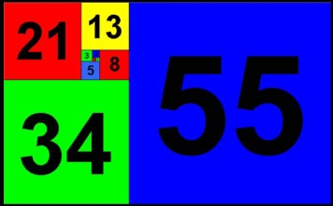
Sequences and Series
The nth term of an arithmetic sequence
All arithmetic sequences take the form:
We can put this together as a relationship for the nth term of an arithmetic sequence…
Where ‘a’ is the first term and ‘d’ is the common difference.
Example 1
Find the 50th term of the following sequences:
a) 4, 7, 10, 13…
and
b) 100, 93, 86, 79…
a = 4
d = 3
a = 100
d = -7
1st term
2nd term
3rd term
4th term
5th term
a)
b)
6E

Slide 18
Sequences and Series
The nth term of an arithmetic sequence
All arithmetic sequences take the form:
We can put this together as a relationship for the nth term of an arithmetic sequence…
Where ‘a’ is the first term and ‘d’ is the common difference.
Example 2
For the following sequence, calculate the number of terms.
5 + 9 + 13 + 17 + 21 + … + 805
a = 5
d = 4
1st term
2nd term
3rd term
4th term
5th term
Substitute numbers in
Work out the bracket
Group together terms
Subtract 1
Divide by 4
There are 201 terms in the sequence!
6E

Slide 19
Sequences and Series
The nth term of an arithmetic sequence
All arithmetic sequences take the form:
We can put this together as a relationship for the nth term of an arithmetic sequence…
Where ‘a’ is the first term and ‘d’ is the common difference.
Example 3
Given that the 3rd term of an arithmetic sequence is 20 and the 7th is 12:
Work out the first term
3rd term
7th term
1st term
2nd term
3rd term
4th term
5th term
1)
2)
2) – 1)
Substitute into 1) or 2)
6E

Slide 20
Teachings for Exercise 6F

Slide 21
Sequences and Series
The Sum of an Arithmetic Series
You need to be able to work out the sum of numbers in an arithmetic sequence.
Add up the numbers from 1-100!
This method was discovered by Carl Friedrich Gauss (1777-1855) while he was still in Primary School!
Write out the same sequence backwards
Add both sequences together
We have 100 lots of 101
Halve that to get the actual total
6F

Slide 22
Sequences and Series
The Sum of an Arithmetic Series
As a general rule:
…, …, …
…, …, …
Group the a’s
Multiply out the bracket
…, …, …
Group the d’s
Factorise the 2nd part
There are ‘n lots of 2a + (n-1)d’
Divide by 2
If L is the last term in the series
6F

Slide 23
Sequences and Series
The Sum of an Arithmetic Series
Example 1
Calculate the value of the first 100 odd numbers:
→ 1, 3, 5, 7, …, …
a = 1
d = 2
n = 100
Substitute numbers in
a = the 1st term
d = the common difference
L = the last term
Work out the inner bracket
50 x 200
6F

Slide 24
Sequences and Series
The Sum of an Arithmetic Series
Example 1
Calculate the value of the first 100 odd numbers:
→ 1, 3, 5, 7, …, …
a = 1
d = 2
n = 100
100th term →
a = the 1st term
d = the common difference
L = the last term
Substitute numbers in
6F

Slide 25
Sequences and Series
The Sum of an Arithmetic Series
Example 2
Find the number of terms needed for the sum of the following sequence to exceed 2000.
4 + 9 + 14 + 19…
S_{n} = 2000
a = 4
d = 5
Substitute numbers in
Multiply by 2
a = the 1st term
d = the common difference
L = the last term
Group together terms
Multiply out the bracket
Subtract 4000
6F

Slide 26
Sequences and Series
The Sum of an Arithmetic Series
Example 2
Find the number of terms needed for the sum of the following sequence to exceed 2000.
4 + 9 + 14 + 19…
a = 5
b = 3
c = -4000
Substitute numbers in
a = the 1st term
d = the common difference
L = the last term
Careful with negatives!
n = 27.9 or -28.5
n = 28 ( need 28 terms to be over 2000)
6F

Slide 27
Teachings for Exercise 6G

Slide 28
Sequences and Series
Sequences Notation
The symbol Σ can be used to mean ‘sum of’:
Highest value of r
Highest value of r
The formula to be used
The formula to be used
The first value of r
The first value of r
So this means the sum of the sequence (2 + 3r) from r = 0 to r = 10
→ Sum of 2 + 5 + 8 + … + 32
So this means the sum of the sequence (10 - 2r) from r = 5 to r = 15
→ Sum of 0 + -2 + -4 + … + -20
6G

Slide 29
Sequences and Series
Sequences Notation
The symbol Σ can be used to mean ‘sum of’:
Example 1
Calculate the value of the following:
a = 5
Highest value of r
d = 4
n = 20
5 + 9 + 13 + … + 81
Sub numbers in
The formula to be used
The first value of r
Work out brackets
6G

Slide 30
Summary
We have looked at sequences
We have seen how to calculate a number in an arithmetic sequence
We have also worked out the sum of a sequence
We have also seen some of the notation which is used in sequences

