Slide 1
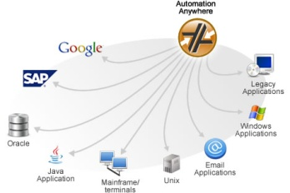
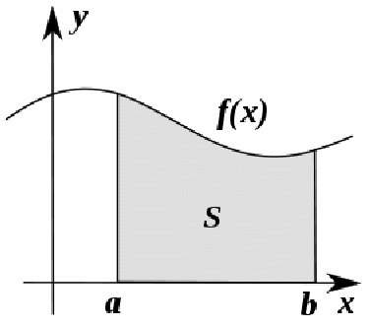
Integration

Slide 2
Introduction
We have seen how to Integrate in C1
In C2 we start to use Integration, to work out areas below curves
It is increasingly important in this Chapter that you use clear workings

Slide 3
Teachings for Exercise 11A

Slide 4
Integration
You need to be able to integrate functions within defined limits
Your workings must be clear here. There are 3 stages…
Example Question
Evaluate the following:
Integrate the function and put it in square brackets. Put the ‘limits’ outside the bracket.
The statement. Basically the function written out, with values for a and b
Split the integration into 2 separate brackets
After integration. The function is integrated and put into square brackets
Substitute ‘b’ into the first, and ‘a’ into the second
The evaluation. Round brackets are used to split the integration in two. One part for b and one for a.
Calculate the final value.
11A

Slide 5
Integration
You need to be able to integrate functions within defined limits
Your workings must be clear here. There are 3 stages…
Example Question
Evaluate the following:
Integrate the function and put it in square brackets. Put the ‘limits’ outside the bracket.
The statement. Basically the function written out, with values for a and b
After integration. The function is integrated and put into square brackets
Simplify if possible
Split and substitute
The evaluation. Round brackets are used to split the integration in two. One part for b and one for a.
11A

Slide 6
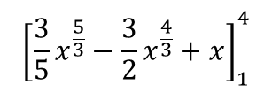
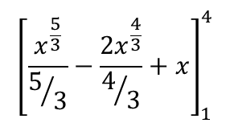
Integration
You need to be able to integrate functions within defined limits
Your workings must be clear here. There are 3 stages…
Example Question
Evaluate the following:
Sometimes you will have to simplify an expression before integrating
$${\left[\frac{x^{\frac{5}{3}}}{5/3}−\frac{{2x}^{\frac{4}{3}}}{4/3}+x\right]}_{1}^{4}$$
Integrate into Square Brackets
Simplify
$${\left[{\frac{3}{5}x}^{\frac{5}{3}}−\frac{3}{2}x^{\frac{4}{3}}+x\right]}_{1}^{4}$$
Split into 2 and substitute b and a
11A

Slide 7
Teachings for Exercise 11B

Slide 8
Integration
You need to be able to use definite Integration to find areas under curves
To find the area under a curve, between two values of x, you follow the process we have just learnt.
The values of a and b will be the limits of the Area, and y is the function of the curve.
It is important to note that when we say ‘the area under the curve’, this means the area between the curve and the x-axis.
y = f(x)
R
a
b
11B

Slide 9
Integration
You need to be able to use definite Integration to find areas under curves
To find the area under a curve, between two values of x, you follow the process we have just learnt.
The values of a and b will be the limits of the Area, and y is the function of the curve.
It is important to note that when we say ‘the area under the curve’, this means the area between the curve and the x-axis.
Example Question
Find the area of the region R bounded by the curve with equation y = (4 - x)(x + 2), and the y and x axes.
-2
4
11B

Slide 10
Integration
You need to be able to use definite Integration to find areas under curves
To find the area under a curve, between two values of x, you follow the process we have just learnt.
The values of a and b will be the limits of the Area, and y is the function of the curve.
It is important to note that when we say ‘the area under the curve’, this means the area between the curve and the x-axis.
Example Question
Find the value of R, where R is the area between the values of x = 1 and x = 3, and under the following curve:
Rewrite
Integrate
Split and Substitute
11B

Slide 11
Teachings for Exercise 11C

Slide 12

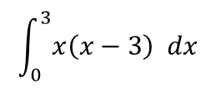
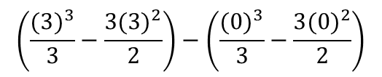
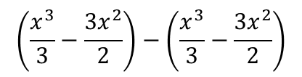
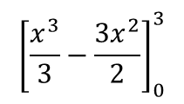
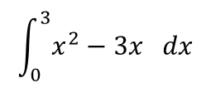

Integration
You need to be able to work out areas of curves which have a section under the x-axis
Find the area of the finite region bounded by the curve y = x(x – 3) and the x-axis
Start with a sketch…
The graph will cross the x-axis at 0 and 3…
In this case you can see the region is below the x-axis…
$$\int_{0}^{3}{x\left(x−3\right) dx}$$
Multiply out the bracket
$$\int_{0}^{3}{x^{2}−3x dx}$$
Integrate and use a squared bracket
$${\left[\frac{x^{3}}{3}−\frac{{3x}^{2}}{2}\right]}_{0}^{3}$$
Write as two separate parts
$$\left(\frac{x^{3}}{3}−\frac{{3x}^{2}}{2}\right)−\left(\frac{x^{3}}{3}−\frac{{3x}^{2}}{2}\right)$$
Substitute in the limits
$$\left(\frac{{(3)}^{3}}{3}−\frac{{3(3)}^{2}}{2}\right)−\left(\frac{{(0)}^{3}}{3}−\frac{{3(0)}^{2}}{2}\right)$$
0
3
Work out each part
$$\left(−4.5\right)−\left(0\right)$$
Calculate
$$=−4.5$$
So the area is 4.5 square units (you can write is as a positive value…)
11C

Slide 13
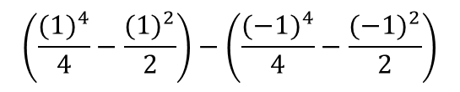
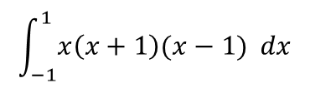
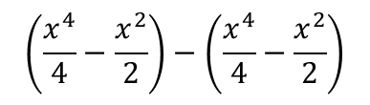
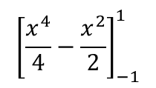
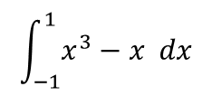

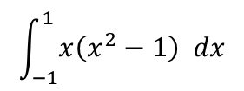

Integration
$$\int_{−1}^{1}{x\left(x+1\right)(x−1) dx}$$
You need to be able to work out areas of curves which have a section under the x-axis
Find the area between the curve:
y = x(x + 1)(x – 1)
and the x-axis
Again, start with a sketch…
You can see this time that part of the curve is above the axis and part is below…
Multiply out the double bracket
$$\int_{−1}^{1}{x\left(x^{2}−1\right) dx}$$
$$\int_{−1}^{1}{x^{3}−x dx}$$
Multiply out the rest
Integrate and use a squared bracket
$${\left[\frac{x^{4}}{4}−\frac{x^{2}}{2}\right]}_{−1}^{1}$$
Use two separate brackets
$$\left(\frac{x^{4}}{4}−\frac{x^{2}}{2}\right)−\left(\frac{x^{4}}{4}−\frac{x^{2}}{2}\right)$$
Sub in the limits 1 and -1
0
$$\left(\frac{{(1)}^{4}}{4}−\frac{{(1)}^{2}}{2}\right)−\left(\frac{{(−1)}^{4}}{4}−\frac{{(−1)}^{2}}{2}\right)$$
-1
1
Work out each part
$$\left(−0.5\right)−\left(−0.5\right)$$
Calculate
$$=0$$
If a region is part above and part below, this process will not work…
11C

Slide 14
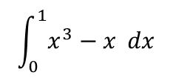

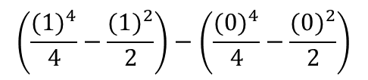
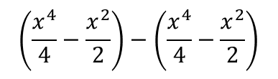
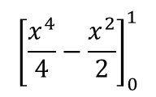
Integration
→ You need to integrate each section separately and then combine them (as positive values…)
You need to be able to work out areas of curves which have a section under the x-axis
Find the area between the curve:
y = x(x + 1)(x – 1)
and the x-axis
Again, start with a sketch…
You can see this time that part of the curve is above the axis and part is below…
First section (below the axis)
$$\int_{0}^{1}{x^{3}−x dx}$$
Integrate and use a squared bracket
$${\left[\frac{x^{4}}{4}−\frac{x^{2}}{2}\right]}_{0}^{1}$$
Split into two separate parts
$$\left(\frac{x^{4}}{4}−\frac{x^{2}}{2}\right)−\left(\frac{x^{4}}{4}−\frac{x^{2}}{2}\right)$$
Sub in the limits for this region only
$$\left(\frac{{(1)}^{4}}{4}−\frac{{(1)}^{2}}{2}\right)−\left(\frac{{(0)}^{4}}{4}−\frac{{(0)}^{2}}{2}\right)$$
-1
0
1
Calculate
$$=−0.5$$
0.5 square units
So the area in the section under the axis will be 0.5 square units…
11C

Slide 15
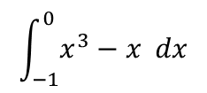

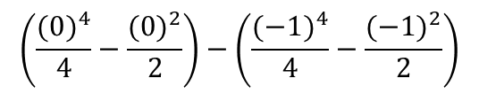
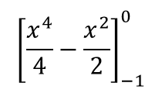
Integration
→ You need to integrate each section separately and then combine them (as positive values…)
You need to be able to work out areas of curves which have a section under the x-axis
Find the area between the curve:
y = x(x + 1)(x – 1)
and the x-axis
Again, start with a sketch…
You can see this time that part of the curve is above the axis and part is below…
Second section (above the axis)
$$\int_{−1}^{0}{x^{3}−x dx}$$
Integrate and use a squared bracket (you won’t need to work this out again as you have it from before!)
$${\left[\frac{x^{4}}{4}−\frac{x^{2}}{2}\right]}_{−1}^{0}$$
Split into two separate parts
$$\left(\frac{x^{4}}{4}−\frac{x^{2}}{2}\right)−\left(\frac{x^{4}}{4}−\frac{x^{2}}{2}\right)$$
0.5 square units
Sub in the limits for this region only
$$\left(\frac{{(0)}^{4}}{4}−\frac{{(0)}^{2}}{2}\right)−\left(\frac{{(−1)}^{4}}{4}−\frac{{(−1)}^{2}}{2}\right)$$
-1
0
1
Calculate
$$=0.5$$
0.5 square units
So the area in the section above the axis will be 0.5 square units…
The total area is therefore 1 square unit!
11C

Slide 16
Teachings for Exercise 11D

Slide 17
Integration
You need to be able to calculate the Area between a Curve and a Straight Line
To work out the Region between 2 lines, you work out the region below the ‘higher’ line, and subtract the region below the ‘lower’ line
y
Region R
y₂
y₁
x
a
b
→ Sometimes you will need to work out the values of a and b
→ Sometimes a and b will be different for each part
→ MAKE SURE you put y₁ and y₂ the correct way around!
11D

Slide 18
Integration
You need to be able to calculate the Area between a Curve and a Straight Line
To work out the Region between 2 lines, you work out the region below the ‘higher’ line, and subtract the region below the ‘lower’ line
Example Question
Below is a diagram showing the equation y = x, as well as the curve y = x(4 – x). Find the Area bounded by the two lines.
y
y = x
1) Find where the lines cross (set the equations equal)
R
Expand the bracket
x
Subtract x
0
3
Factorise
y = x(4 – x)
11D

Slide 19
Integration
You need to be able to calculate the Area between a Curve and a Straight Line
To work out the Region between 2 lines, you work out the region below the ‘higher’ line, and subtract the region below the ‘lower’ line
Example Question
Below is a diagram showing the equation y = x, as well as the curve y = x(4 – x). Find the Area bounded by the two lines.
y
y = x
2) Integrate to find the Area
R
Expand and rearrange (higher equation – lower equation)
x
0
3
Integrate
Split and Substitute
y = x(4 – x)
11D

Slide 20
Integration
You need to be able to calculate the Area between a Curve and a Straight Line
To work out the Region between 2 lines, you work out the region below the ‘higher’ line, and subtract the region below the ‘lower’ line
Example Question
The diagram shows a sketch of the curve with equation y = x(x – 3), and the line with Equation 2x. Calculate the Area of region R.
y = x(x – 3)
y
y = 2x
(5,10)
A
1) Work out the coordinates of the major points..
As the curve is y = x(x – 3), the x-coordinate at C = 3
→ Set the equations equal to find the x-coordinates where they cross…
R
x
0
O
3
C
5
B
Expand Bracket
Subtract 2x
Factorise
The Area we want will be The Area of Triangle OAB – The Area ACB, under the curve.
11D

Slide 21
Integration
You need to be able to calculate the Area between a Curve and a Straight Line
To work out the Region between 2 lines, you work out the region below the ‘higher’ line, and subtract the region below the ‘lower’ line
Example Question
The diagram shows a sketch of the curve with equation y = x(x – 3), and the line with Equation 2x. Calculate the Area of region R.
y = x(x – 3)
y
y = 2x
(5,10)
2) Area of the Triangle…
R
Substitute values in
x
0
3
5
Work it out!
Area of Triangle OAB – The Area ACB
25
11D

Slide 22
Integration
You need to be able to calculate the Area between a Curve and a Straight Line
To work out the Region between 2 lines, you work out the region below the ‘higher’ line, and subtract the region below the ‘lower’ line
Example Question
The diagram shows a sketch of the curve with equation y = x(x – 3), and the line with Equation 2x. Calculate the Area of region R.
y = x(x – 3)
y
y = 2x
(5,10)
3) Area under the curve
16 ¹/₃
R
Expand Bracket
x
0
3
5
Integrate
Split and Substitute
Area of Triangle OAB – The Area ACB
25
-
²⁶/₃
11D

Slide 23
Teachings for Exercise 11E

Slide 24
Integration
y
Sometimes you may need to find the area beneath a curve which is very hard to Integrate. In this case you can use the ‘trapezium rule’ to approximate the area
Imagine we had a curve as shown to the right, and we wanted to find the area in the region indicated
We could split the region into strips, all of the same height (in this case 3), and work out the area of each strip as a trapezium
We could then add them together and the area would be an approximation for the area under the curve
→ If we want a better approximation, we just need to use more strips…
y₀
y₁
y₂
y₃
a
h
h
h
b
x
y
y₀
y₁
y₂
y₃
y₄
y₅
a
h
h
h
h
h
b
x
11E

Slide 25





Integration
Sometimes you may need to find the area beneath a curve which is very hard to Integrate. In this case you can use the ‘trapezium rule’ to approximate the area
Lets see what the algebra would look like for using the trapezium rule in a question…
y₀
y₁
y₁
y₂
y₂
y₃
h
h
h
$$Area=\frac{1}{2}h\left(y_{0}+y_{1}\right)$$
$$Area=\frac{1}{2}h\left(y_{1}+y_{2}\right)$$
$$Area=\frac{1}{2}h\left(y_{2}+y_{3}\right)$$
y
$Total Area=\frac{1}{2}h\left(y_{0}+y_{1}\right)+\frac{1}{2}h\left(y_{1}+y_{2}\right)$+$\frac{1}{2}h\left(y_{2}+y_{3}\right)$
$$=\frac{1}{2}h\left(y_{0}+y_{1}+y_{1}+y_{2}+y_{2}+y_{3}\right)$$
y₀
y₁
y₂
y₃
$$=\frac{1}{2}h\left[y_{0}+{2(y}_{1}+y_{2})+y_{3}\right]$$
h
h
h
x
11E

Slide 26
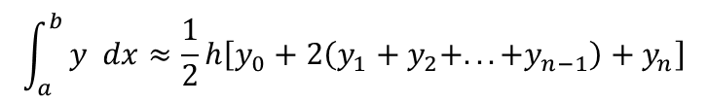

Integration
Sometimes you may need to find the area beneath a curve which is very hard to Integrate. In this case you can use the ‘trapezium rule’ to approximate the area
As a general case, the trapezium rule looks like this:
and
$$\int_{a}^{b}{y dx≈\frac{1}{2}h\left[y_{0}+2\left(y_{1}+y_{2}+...+y_{n−1}\right)+y_{n}\right]}$$
$$h=\frac{b−a}{n}$$
The height of each strip is given by the difference between the limits, divided by ‘n’, the number of strips…
11E

Slide 27






Integration
$$\int_{a}^{b}{y dx≈\frac{1}{2}h\left[y_{0}+2\left(y_{1}+y_{2}+...+y_{n−1}\right)+y_{n}\right]}$$
$$h=\frac{b−a}{n}$$
Sometimes you may need to find the area beneath a curve which is very hard to Integrate. In this case you can use the ‘trapezium rule’ to approximate the area
Using 4 strips, estimate the area under the curve:
Between the lines x = 0 and x = 2
You will not need to integrate at all to do this (which is good because you do not know how to integrate a function like this… yet!)
Start by finding the height of each strip…
h = 0.5
$$h=\frac{b−a}{n}$$
Sub in values from the question
$$h=\frac{2−0}{4}$$
Calculate
$$h=0.5$$
$$y=\sqrt{2x+3}$$
So the height (horizontally!) of each strip will be 0.5 units
11E

Slide 28
Integration
$$\int_{a}^{b}{y dx≈\frac{1}{2}h\left[y_{0}+2\left(y_{1}+y_{2}+...+y_{n−1}\right)+y_{n}\right]}$$
$$h=\frac{b−a}{n}$$
Between x = 0 and x = 2, the height of each strip is 0.5…
Sometimes you may need to find the area beneath a curve which is very hard to Integrate. In this case you can use the ‘trapezium rule’ to approximate the area
Using 4 strips, estimate the area under the curve:
Between the lines x = 0 and x = 2
You will not need to integrate at all to do this (which is good because you do not know how to integrate a function like this… yet!)
Start by finding the height of each strip…
h = 0.5
Now draw up a table and work out y values at the appropriate x positions between 0 and 2…
x
0
0.5
1
1.5
2
y
1.732
2
2.236
2.449
2.646
$$y=\sqrt{2x+3}$$
For each of these values of x, calculate the value of y by substituting it into the equation of the curve
These are the heights of each strip!
You can now substitute these values into the formula (the first is y₀, the second is y₁ etc)
11E

Slide 29



Integration
$$\int_{a}^{b}{y dx≈\frac{1}{2}h\left[y_{0}+2\left(y_{1}+y_{2}+...+y_{n−1}\right)+y_{n}\right]}$$
$$h=\frac{b−a}{n}$$
Sometimes you may need to find the area beneath a curve which is very hard to Integrate. In this case you can use the ‘trapezium rule’ to approximate the area
Using 4 strips, estimate the area under the curve:
Between the lines x = 0 and x = 2
Now sub the values you worked out into the formula – the first value for y is y₀ and the last is y_{n}
x
0
0.5
1
1.5
2
y
1.732
2
2.236
2.449
2.646
$$\int_{a}^{b}{y dx≈\frac{1}{2}h\left[y_{0}+2\left(y_{1}+y_{2}+...+y_{n−1}\right)+y_{n}\right]}$$
$$y=\sqrt{2x+3}$$
$$\int_{0}^{2}{\sqrt{2x+3} dx≈\frac{1}{2}(0.5)\left[1.732+2\left(2+2.236+2.449\right)+2.646\right]}$$
$$=4.437 square units$$
11E

Slide 30


Integration
$$\int_{a}^{b}{y dx≈\frac{1}{2}h\left[y_{0}+2\left(y_{1}+y_{2}+...+y_{n−1}\right)+y_{n}\right]}$$
$$h=\frac{b−a}{n}$$
Sometimes you may need to find the area beneath a curve which is very hard to Integrate. In this case you can use the ‘trapezium rule’ to approximate the area
Using 8 strips, estimate the area under the curve:
Between the lines x = 0 and x = 2
You will not need to integrate at all to do this (which is good because you do not know how to integrate a function like this… yet!)
Start by finding the height of each strip…
h = 0.25
$$h=\frac{b−a}{n}$$
Sub in values from the question
$$h=\frac{2−0}{8}$$
Calculate
$$h=0.25$$
$$y=\sqrt{2x+3}$$
So the height (horizontally!) of each strip will be 0.25 units
11E

Slide 31


Integration
$$\int_{a}^{b}{y dx≈\frac{1}{2}h\left[y_{0}+2\left(y_{1}+y_{2}+...+y_{n−1}\right)+y_{n}\right]}$$
$$h=\frac{b−a}{n}$$
Between x = 0 and x = 2, the height of each strip is 0.25…
Sometimes you may need to find the area beneath a curve which is very hard to Integrate. In this case you can use the ‘trapezium rule’ to approximate the area
Using 8 strips, estimate the area under the curve:
Between the lines x = 0 and x = 2
x
0
0.25
0.5
0.75
1
y
1.732
1.871
2
2.121
2.236
x
1.25
1.5
1.75
2
$$y=\sqrt{2x+3}$$
y
2.345
2.449
2.550
2.646
$$\int_{a}^{b}{y dx≈\frac{1}{2}h\left[y_{0}+2\left(y_{1}+y_{2}+...+y_{n−1}\right)+y_{n}\right]}$$
$$\int_{0}^{2}{\sqrt{2x+3} dx≈\frac{1}{2}(0.25)\left[1.732+2\left(1.871+2+2.121+2.236+2.345+2.449+2.550\right)+2.646\right]}$$
$$=4.440 square units$$
Note that this will be a better estimate as the area was split into more strips!
11E

Slide 32
Summary
We have built on our knowledge of Integration from C1
We have seen how to use Integration to find the area under a curve
We have also used the Trapezium rules for equations that we are unable to integrate easily!

