Slide 1
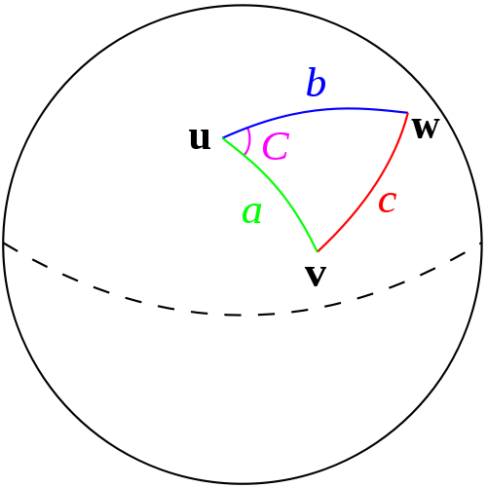
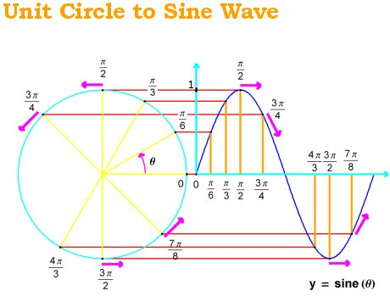
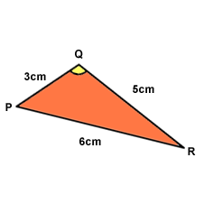
The Sine and Cosine Rules

Slide 2
Introduction
This Chapter involves the use of 3 formulae you saw at GCSE level
We will be using these to calculate missing values in triangles
We will also see where these forumlae come from

Slide 3
Teachings for Exercise 2A and 2B

Slide 4

The Sine and Cosine Rules
B
Consider the triangle labelled to the right, remembering GCSE trigonometry:
Right hand triangle:
Left hand triangle:
The opposite sides are the same so:
hyp
hyp
c
a
opp
A
C
adj
b
adj
O
S
H
Divide by c and a
2A/B

Slide 5
The Sine and Cosine Rules
Calculate the labelled side in the triangle to the right:
Have the unknown as the numerator!
8mm
Substitute numbers in
82°
x
Multiply by Sin82
34°
Work out the fraction
2A/B

Slide 6
The Sine and Cosine Rules
Calculate the labelled angle in the triangle to the right:
Have the unknown as the numerator!
θ
15cm
Substitute numbers in
32°
12cm
Multiply by 12
Work out the fraction
Use Inverse Sine
2A/B

Slide 7
Teachings for Exercise 2C

Slide 8
The Sine and Cosine Rules
There are sometimes 2 solutions for a missing angle:
The Sine graph is symmetrical so the value of Sin 30 is the same as Sin 150.
Generally:
y = Sinθ
90
180
270
360
Sin30 = Sin150
2C

Slide 9
The Sine and Cosine Rules
B
In triangle ABC, AB = 4cm, BC = 3cm and angle BAC = 44°. Work out the possible values of ACB.
4cm
3cm
3cm
44°
A
C
C
Substitute
Multiply by 4
Work out the fraction
Inverse Sine
Work out the other possible value
2C

Slide 10
Teachings for Exercise 2D and 2E

Slide 11






The Sine and Cosine Rules
C
You need to know and be able to use the Cosine rule to find an unknown side or angle
As with the Sine rule, we will see where this rule comes from first!
Consider the triangle to the right, labelled using A, B and C, and a, b and c as you are familiar with
Let us draw on the perpendicular height and call it h, down to a point X
This splits side c into two sections
One we will call ‘x’, meaning the other section is ‘c – x’
b
a
h
A
x
c - x
B
X
c
Using Pythagoras’ Theorem in the left triangle, to find length h
Replace with the letters used on the diagram
Using Pythagoras’ Theorem in the right triangle, to find length h
Replace with the letters used on the diagram
→We now have two expressions for h². These expressions must be the same and can therefore be set equal to each other!
2D/E

Slide 12









The Sine and Cosine Rules
C
A
Hyp
You need to know and be able to use the Cosine rule to find an unknown side or angle
As with the Sine rule, we will see where this rule comes from first!
Consider the triangle to the right, labelled using A, B and C, and a, b and c as you are familiar with
Let us draw on the perpendicular height and call it h, down to a point X
This splits side c into two sections
One we will call ‘x’, meaning the other section is ‘c – x’
C
H
b
a
h
A
x
c - x
B
X
Adj
c
Square the bracket
‘Multiply it out’ – careful with negatives!
Add x² to both sides
Rearrange
You can replace x with an equivalent expression by using GCSE Trigonometry…
Simplify
2D/E

Slide 13





The Sine and Cosine Rules
You need to know and be able to use the Cosine rule to find an unknown side or angle
Coastguard station B is 8km on a bearing of 060˚ from coastguard station A. A ship C is 4.8km, on a bearing of 018˚, away from A.
Calculate the distance from C to B
Start with a diagram (this will help a lot!)
Label the side you are finding ‘a’ (in this case the letters work out nicely, but with different letters it is sometimes easier to ignore them and use a, b and c)
N
C
a
b
B
4.8km
18˚
42˚
8km
60˚
c
A
Replace a, b and c as appropriate
Calculate the right-hand side
Square root the answer
2D/E

Slide 14






The Sine and Cosine Rules
a
b
You need to know and be able to use the Cosine rule to find an unknown side or angle
A triangle has sides of 4cm, 5cm and 6cm respectively. Find the size of the smallest angle
The smallest angle will always be opposite the smallest side
Call this angle ‘A’
Proceed as before, but you will have to do a little more rearranging…
4cm
5cm
6cm
A
c
Sub in appropriate values for a, b and c
Calculate some terms
Subtract 61
Divide by -60
Use inverse Cos
2D/E

Slide 15












The Sine and Cosine Rules
P
c
a
You need to know and be able to use the Cosine rule to find an unknown side or angle
In the triangle to the right, PQ = xcm, QR = (x + 2)cm, RP = 5cm and angle PQR = 60˚. Find the value of x.
x cm
5cm
60˚
Q
R
A
(x + 2) cm
b
Sub in appropriate values for a, b and c
Sub in a, b and c…
Expand brackets
→ Cos60 = 0.5
Calculate
Simplify
Rearrange into a solvable form
Work out answers
There is also a negative solution but this would not make sense in context so we do not need it (it would be good workings to show it though!)
a = 1
b = 2
c = -21
We can use the Quadratic formula!
2D/E

Slide 16
Exercise 2F is just a mixture
of the topics up until now!

Slide 17
Teachings for Exercise 2G

Slide 18





The Sine and Cosine Rules
A
Hyp
You need to be able to calculate the area of a triangle using Sine
Again, we will start by seeing where this formula comes from…
In the triangle to the right, the area will be given by ¹/₂ base x height
The base is ‘a’ and the height is ‘h’
But we can work out an expression for h by using GCSE Trigonometry in the right hand triangle
This allows us to replace h in the formula, with bSinC instead
(The point of this is to allow us to find the area of a triangle by using an angle and 2 sides, without needing the perpendicular height!)
O
S
H
c
b
Opp
h
B
C
a
Replace h with bSinC
Remove the bracket
→ To use this you are looking to know 2 sides as well as the angle between them
2G

Slide 19


The Sine and Cosine Rules
A
b
You need to be able to calculate the area of a triangle using Sine
Calculate the area of the triangle shown to the right…
c
4.2cm
B
75˚
6.8cm
C
a
Sub in values
Calculate
2G

Slide 20







The Sine and Cosine Rules
C
a
x
30°
You need to be able to calculate the area of a triangle using Sine
The area of the triangle to the right is 60cm².
→ Show that x² – 3x - 240 = 0
B
x - 3
c
b
Sub in values
A
Multiply by 2 to cancel out the ¹/₂
Sin30 = 0.5
Multiply by 2 again to cancel out the 0.5
Expand the bracket
Subtract 240
2G

Slide 21
Summary
We have practised using the Sine, Cosine and area of a triangle rules
We have seen questions with combinations of these
We have also looked at solving algebraic questions incorporating these topics

