Slide 1
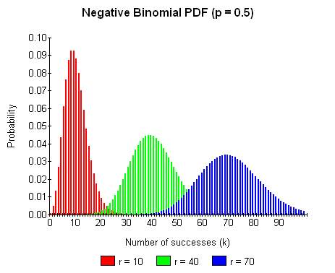
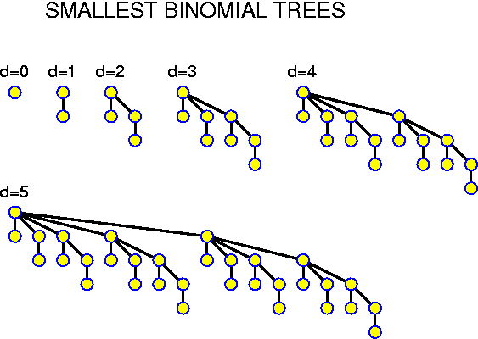
The Binomial Expansion

Slide 2
Introduction
Binomial Expansion is a way of expanding the same bracket very quickly, whatever power it is raised to
It can be used in probability, in determining how many ways an event can happen
We will see an example of this once we have understood the process which we go through in expanding the bracket

Slide 3
Teachings for Exercise 5A

Slide 4
The Binomial Expansion
You can work out brackets ‘the long way’, by multiplying out 2, then multiplying by the next bracket and so on…
5A

Slide 5
The Binomial Expansion
You end up with this pattern…
There is a pattern in the coefficients (the numbers at the front of each term)
5A

Slide 6
The Binomial Expansion
The coefficients make a pattern known as Pascal’s triangle
1
You work out each number by adding the 2 above it.
Number 1s always go down the edges
1
1
1
2
1
1
3
3
1
1
4
6
4
1
1
5
10
10
5
1
5A

Slide 7
The Binomial Expansion
For (a + b)^{n}
Find the expansion of (x + 2y)³
n = 0
n = 1
n = 3, so use the relevant row
n = 2
n = 3
Sub in for a and b
n = 4
Simplify
Careful, (2y)² = 4y²
Now fully simplify
5A

Slide 8
The Binomial Expansion
For (a + b)^{n}
Find the expansion of (2x - 5)⁴
n = 4, so use the relevant row
Work out each part carefully
Careful with negatives!
Simplify as much as you can
5A

Slide 9
The Binomial Expansion
For (a + b)^{n}
The coefficient of x² in the expansion of (2 - cx)³ is 294. Find the value of c.
Using n = 3
The ‘x’ will be substituted in for b, so we want the term which has b²
Sub in for a and b
Careful with negatives!
6c² is the coefficient of x², so must be equal to 294
Divide by 6
2 possible answers
5A

Slide 10
Teachings for Exercise 5B

Slide 11
The Binomial Expansion
You can use combinations and factorials to work out the Binomial Expansion. This is quicker for higher indices.
Suppose that 3 people are running a race. There are 6 different possible outcomes for their final positions.
This can be calculated as;
3 x 2 x 1
3 x 2 x 1 can be written as 3! (3 factorial)
n! = n x (n-1) x (n-2)…………x 3 x 2 x 1
A, B, C
A, C, B
B, A, C
B, C, A
C, A, B
C, B, A
3 possibilities for 1st
After 1st is decided, 2 possibilities for 2nd
After 1st and 2nd, only 1 runner is left
0! = 1 (by definition)
5B

Slide 12
The Binomial Expansion
You can use combinations and factorials to work out the Binomial Expansion. This is quicker for higher indices.
Suppose we want to choose 2 letters from X, Y and Z, where order does not matter. There are 3 possible outcomes.
This can be written as:
To calculate it, you would work out the following.
X, Y
X, Z
Y, Z
or
(2 items to choose from 3 options)
5B

Slide 13

The Binomial Expansion
You can use combinations and factorials to work out the Binomial Expansion. This is quicker for higher indices.
In general, to work out how many ways of choosing ‘r’ items from a group of n items is written as:
It can be calculated using this general formula;
Calculate the number of ways of choosing 2 items from a selection of 5
5 items, so n = 5.
2 Choices, so r = 2
or
(r items to choose from n options)
5 – 2 = 3
3! = 6
5B

Slide 14
Teachings for Exercise 5C

Slide 15
The Binomial Expansion
You can use to work out the coefficients in the Binomial Expansion
This method will seem more complicated at first, but with higher powers it is easier.
You will most likely need a calculator to work out some of the factorials
The Binomial Expansion is;
r is effectively the ‘position’ in the expansion
You will need the formula from the previous section
n is the power which the bracket is raised to
5C

Slide 16
The Binomial Expansion
Calculate the Binomial Expansion of (2x + y)⁴
n = 4
a = 2x
b = y
=
=
=
5C

Slide 17
The Binomial Expansion
Calculate the Binomial Expansion of (3 – 2x)⁵
n = 5
a = 3
b = -2x
=
=
=
=
You will always get either all positives, or a positive/negative alternating pattern…
5C

Slide 18
The Binomial Expansion
You will not always be asked to expand the whole thing!
Find the first 4 terms in ascending powers of x of
Then, by using a suitable substitution, find an approximate value for 0.975¹⁰
5C

Slide 19
Teachings for Exercise 5D

Slide 20
The Binomial Expansion
There is a shortened version of the expansion when one of the terms is 1
Whatever power 1 is raised to, it will be 1, and can therefore be ignored
The coefficients give values from Pascal’s triangle.
→ For example, if n was 4…
5D

Slide 21
The Binomial Expansion
Find the first 4 terms of the Binomial expansion of (1 + 2x)⁵
Put the numbers in
Work out the fractions
Simplify
5D

Slide 22
The Binomial Expansion
Find the first 4 terms of the Binomial expansion of (2 - x)⁶
6
[
]
Put the numbers in
Work out the fractions
Simplify
Remember to multiply by 64!
5D

Slide 23
Summary
We have learnt how to expand many brackets when raised to a power
We have seen several ways to do this, which all fit certain circumstances
We also saw various questions on working out coefficients, as well as the brackets themselves

