Slide 1
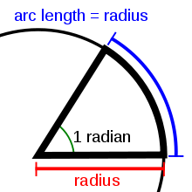
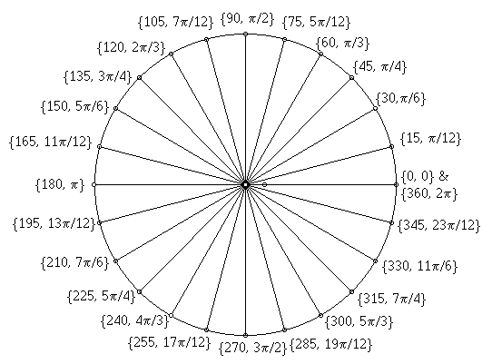
Radian measure and its Applications

Slide 2
Introduction
This Chapter focuses on using ‘Radians’ when answering questions involving circles
Radians are an alternative to degrees
Radians are quicker to use than degrees (when you get used to them)
They also allow extra calculations which would be much more difficult to do using degrees instead…

Slide 3
Teachings for Exercise 6A

Slide 4
Radian measure and its Applications
You can measure angles in Radians
Radians are an alternative to degrees. Some calculations involving circles are easier when Radians are used, as opposed to degrees.
‘If arc AB has length r, then angle AOB is 1 radian (1^{c} or 1 rad)’
A
r
O
1^{c}
r
r
B
Arc Length
Multiply by 2π
Arc Length
2πr is the circumference
÷ 2
÷ π
6A

Slide 5
Radian measure and its Applications
You can measure angles in Radians
You need to be able to convert between degrees and radians.
Convert the following angle to degrees
Multiply by ¹⁸⁰/_{π}
Radians → Degrees
Top x Top, Bottom x Bottom
Multiply by ¹⁸⁰/_{π}
Cancel out π
Work out the sum
6A

Slide 6
Radian measure and its Applications
You can measure angles in Radians
You need to be able to convert between degrees and radians.
Convert the following angle to degrees
Multiply by ¹⁸⁰/_{π}
Radians → Degrees
Top x Top, Bottom x Bottom
Multiply by ¹⁸⁰/_{π}
Cancel out π
Work out the sum
6A

Slide 7
Radian measure and its Applications
You can measure angles in Radians
You need to be able to convert between degrees and radians.
Convert the following angle to radians
Multiply by ^{π}/₁₈₀
Degrees → Radians
Only multiply the top here
Divide by ¹⁸⁰/_{π}
Simplify
Multiply by ^{π}/₁₈₀
6A

Slide 8
Radian measure and its Applications
You can measure angles in Radians
You need to be able to convert between degrees and radians.
Convert the following angle to radians
Multiply by ^{π}/₁₈₀
Degrees → Radians
Only multiply the top here
Divide by ¹⁸⁰/_{π}
Simplify
Multiply by ^{π}/₁₈₀
6A

Slide 9
Teachings for Exercise 6B

Slide 10
Radian measure and its Applications
Finding the length of an arc is easier when you use radians
r
θ
l
=
r
=
Multiply by 2π
=
Multiply by r
=
(The angle must be in radians!)
6B

Slide 11
Radian measure and its Applications
Finding the length of an arc is easier when you use radians
Find the length of the arc of a circle of radius 5.2cm. The arc subtends an angle of 0.8^{c} at the centre of the circle.
=
=
=
6B

Slide 12
Radian measure and its Applications
Finding the length of an arc is easier when you use radians
Arc AB of a circle, with centre O and radius r, subtends an angle of θ radians at O. The Perimeter of sector AOB is P cm. Express r in terms of θ.
Length AB = rθ
Factorise
Divide by (θ + 2)
A
r
O
θ
rθ
r
B
6B

Slide 13
Radian measure and its Applications
Calculator in Radians
Finding the length of an arc is easier when you use radians
The border of a garden pond consists of a straight edge AB of length 2.4m, and a curved part C, as shown in the diagram below. The curved part is an arc of a circle, centre O and radius 2m. Find the length of C.
O
(H)
2m
x
A
1.2m
B
Inverse sine
(O)
Double for angle AOB
C
Angle θ = 2π – 1.287
Angle θ = 4.996 rad
θ
4.996^{c}
2m
2m
O
1.287^{c}
A
2.4m
B
(We need to work out angle θ)
6B

Slide 14
Teachings for Exercise 6C

Slide 15
Radian measure and its Applications
The Area of a Sector and Segment can be worked out using Radians
=
A
=
Multiply by π
O
θ
X
=
Multiply by r²
B
=
=
This is the formula’s usual form
6C

Slide 16
Radian measure and its Applications
The Area of a Sector and Segment can be worked out using Radians
In the diagram, the area of the minor sector AOB is 28.9cm². Given that angle AOB is 0.8 rad, calculate the value of r.
Put the numbers in
½ x 0.8 = 0.4
A
Divide by 0.4
r cm
O
0.8^{c}
B
Square root
6C

Slide 17
Radian measure and its Applications
The Area of a Sector and Segment can be worked out using Radians
A plot of land is in the shape of a sector of a circle of radius 55m. The length of fencing that is needed to enclose the land is 176m. Calculate the area of the plot of land.
The length of the arc must be 66m (adds up to 176 total)
Put the numbers in
Divide by 55
A
55m
Put the numbers in
66m
θ
O
1.2^{c}
55m
B
(We need to work out the angle first)
6C

Slide 18
Radian measure and its Applications
The Area of a Sector and Segment can be worked out using Radians
You can also work out the area of a segment using radians.
Area of a Segment
Area of Sector AOB – Area of Triangle AOB
Area of Sector AOB
Area of Triangle AOB
a = b = r
C = θ
O
r
θ
r
Area of the Segment
A
B
Factorise
6C

Slide 19
Radian measure and its Applications
The Area of a Sector and Segment can be worked out using Radians
Calculate the Area of the segment shown in the diagram below.
Substitute the numbers in
Work the parts out
Only round the final answer
O
π 3
2.5cm
6C

Slide 20
Radian measure and its Applications
The Area of a Sector and Segment can be worked out using Radians
In the diagram AB is the diameter of a circle of radius r cm, and angle BOC = θ radians. Given that the Area of triangle AOC is 3 three times that of the shaded segment, show that 3θ – 4sinθ = 0.
Area of the shaded segment
Area of triangle AOC
a = b = r Angle = π-θ
Remember, sin x = sin (180 – x)
C
θ
AOC = 3 x shaded segment
A
0
B
Cancel out ¹/₂r²
Multiply out the brackets
Subtract sinθ
6C

Slide 21
Summary
We have learnt how to change from degrees to radians
We have seen how to do calculations to work out the length of an arc
We have also seen formulae for the Area or a sector and segment

