Slide 1
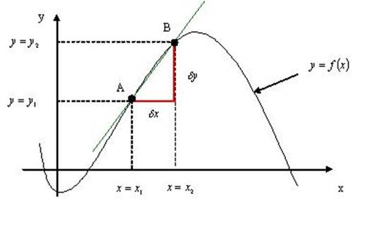

Differentiation

Slide 2
Introduction
We have seen Differentiation in C1
In C2 we will be looking at solving more types of problem
We are also going to be applying the process to worded practical problems

Slide 3
Teachings for Exercise 9A

Slide 4

Differentiation
y
You need to know the difference between Increasing and Decreasing Functions
An increasing function is one with a positive gradient.
A decreasing function is one with a negative gradient.
This function is increasing for all values of x
x
y
This function is decreasing for all values of x
x
9A

Slide 5
Differentiation
y
You need to know the difference between Increasing and Decreasing Functions
An increasing function is one with a positive gradient.
A decreasing function is one with a negative gradient.
Some functions are increasing in one interval and decreasing in another.
x
This function is decreasing for x > 0, and increasing for x < 0
At x = 0, the gradient is 0. This is known as a stationary point.
9A

Slide 6
Differentiation
You need to know the difference between Increasing and Decreasing Functions
An increasing function is one with a positive gradient.
A decreasing function is one with a negative gradient.
Some functions are increasing in one interval and decreasing in another.
You need to be able to work out ranges of values where a function is increasing or decreasing..
Example Question
Show that the function ;
is an increasing function.
Differentiate to get the gradient function
→ Since x² has to be positive, 3x² + 24 will be as well
→ So the gradient will always be positive, hence an increasing function
9A

Slide 7
Differentiation
You need to know the difference between Increasing and Decreasing Functions
An increasing function is one with a positive gradient.
A decreasing function is one with a negative gradient.
Some functions are increasing in one interval and decreasing in another.
You need to be able to work out ranges of values where a function is increasing or decreasing..
Example Question
Find the range of values where:
is an decreasing function.
Differentiate for the gradient function
We want the gradient to be below 0
Factorise
Factorise again
Normally x = -3 and 1
BUT, we want values that will make the function negative…
9A

Slide 8
Differentiation
You need to know the difference between Increasing and Decreasing Functions
Example Question
Find the range of values where:
y
f(x)
is an decreasing function.
Differentiate for the gradient function
We want the gradient to be below 0
x
Factorise
Factorise again
-3
1
Normally x = -3 and 1
BUT, we want values that will make the function negative…
Decreasing Function range
9A

Slide 9
Teachings for Exercise 9B

Slide 10
Differentiation
You need to be able to calculate the co-ordinates of Stationary points, and determine their nature
A point where f(x) stops increasing and starts decreasing is called a maximum point
A point where f(x) stops decreasing and starts increasing is called a minimum point
A point of inflexion is where the gradient is locally a maximum or minimum (the gradient does not have to change from positive to negative, for example)
These are all known as turning points, and occur where f’(x) = 0 (for now at least!)
y
Local maximum
x
Point of inflexion
Local minimum
9B

Slide 11
Differentiation
You need to be able to calculate the co-ordinates of Stationary points, and determine their nature
To find the coordinates of these points, you need to:
1) Differentiate f(x) to get the Gradient Function
2) Solve f’(x) by setting it equal to 0 (as this represents the gradient being 0)
3) Substitute the value(s) of x into the original equation to find the corresponding y-coordinate
y
Local maximum
x
Point of inflexion
Local minimum
9B

Slide 12
Differentiation
You need to be able to calculate the co-ordinates of Stationary points, and determine their nature
To find the coordinates of these points, you need to:
1) Differentiate f(x) to get the Gradient Function
2) Solve f’(x) by setting it equal to 0 (as this represents the gradient being 0)
3) Substitute the value(s) of x into the original equation to find the corresponding y-coordinate
Example Question
Find the coordinates of the turning point on the curve y = x⁴ – 32x, and state whether it is a minimum or maximum.
Differentiate
Set equal to 0
Add 32
Divide by 4, then cube root
Sub 2 into the original equation
The stationary point is at (2, -48)
Work out the y-coordinate
9B

Slide 13
Differentiation
You need to be able to calculate the co-ordinates of Stationary points, and determine their nature
To find the coordinates of these points, you need to:
1) Differentiate f(x) to get the Gradient Function
2) Solve f’(x) by setting it equal to 0 (as this represents the gradient being 0)
3) Substitute the value(s) of x into the original equation to find the corresponding y-coordinate
4) To determine whether the point is a minimum or a maximum, you need to work out f’’(x) (differentiate again!)
Example Question
Find the coordinates of the turning point on the curve y = x⁴ – 32x, and state whether it is a minimum or maximum.
The stationary point is at (2, -48)
Differentiate again
So the stationary point is a MINIMUM in this case!
Sub in the x coordinate
Positive = Minimum
Negative = Maximum
9B

Slide 14
Differentiation
You need to be able to calculate the co-ordinates of Stationary points, and determine their nature
To find the coordinates of these points, you need to:
1) Differentiate f(x) to get the Gradient Function
2) Solve f’(x) by setting it equal to 0 (as this represents the gradient being 0)
3) Substitute the value(s) of x into the original equation to find the corresponding y-coordinate
4) To determine whether the point is a minimum or a maximum, you need to work out f’’(x) (differentiate again!)
Example Question
Find the stationary points on the curve: y = 2x³ – 15x² + 24x + 6, and state whether they are minima, maxima or points of inflexion
Differentiate
Set equal to 0
Factorise
Factorise again
Write the solutions
Substituting into the original formula will give the following coordinates as stationary points:
(1, 17) and (4, -10)
9B

Slide 15
Differentiation
You need to be able to calculate the co-ordinates of Stationary points, and determine their nature
To find the coordinates of these points, you need to:
1) Differentiate f(x) to get the Gradient Function
2) Solve f’(x) by setting it equal to 0 (as this represents the gradient being 0)
3) Substitute the value(s) of x into the original equation to find the corresponding y-coordinate
4) To determine whether the point is a minimum or a maximum, you need to work out f’’(x) (differentiate again!)
Example Question
Find the stationary points on the curve: y = 2x³ – 15x² + 24x + 6, and state whether they are minima, maxima or points of inflexion
Stationary points at: (1, 17) and (4, -10)
Differentiate again
Sub in x = 1
Sub in x = 4
So (1,17) is a Maximum
So (4,-10) is a Minimum
9B

Slide 16
Differentiation
You need to be able to calculate the co-ordinates of Stationary points, and determine their nature
To find the coordinates of these points, you need to:
1) Differentiate f(x) to get the Gradient Function
2) Solve f’(x) by setting it equal to 0 (as this represents the gradient being 0)
3) Substitute the value(s) of x into the original equation to find the corresponding y-coordinate
4) To determine whether the point is a minimum or a maximum, you need to work out f’’(x) (differentiate again!)
Example Question
Find the maximum possible value for y in the formula y = 6x – x². State the range of the function.
Differentiate
Set equal to 0
Solve
Sub x into the original equation
Solve
9 is the maximum, so the range is less than but including 9
9B

Slide 17
Teachings for Exercise 9C

Slide 18
Differentiation
You need to be able to recognise practical problems that can be solved by using the idea of maxima and minima
Whenever you see a question asking about the maximum value or minimum value of a quantity, you will most likely need to use differentiation at some point.
Most questions will involve creating a formula, for example for Volume or Area, and then calculating the maximum value of it.
A practical application would be ‘If I have a certain amount of material to make a box, how can I make the one with the largest volume? (maximum)’
9C

Slide 19
Differentiation
You need to be able to recognise practical problems that can be solved by using the idea of maxima and minima
Example Question
A large tank (shown) is to be made from 54m² of sheet metal. It has no top.
Show that the Volume of the tank will be given by:
1) Try to make formulae using the information you have
Formula for the Volume
x
Formula for the Surface Area (no top)
x
y
3) Substitute the SA formula into the Volume formula, to replace y.
2) Find a way to remove a constant, in this case ‘y’. We can rewrite the Surface Area formula in terms of y.
9C

Slide 20
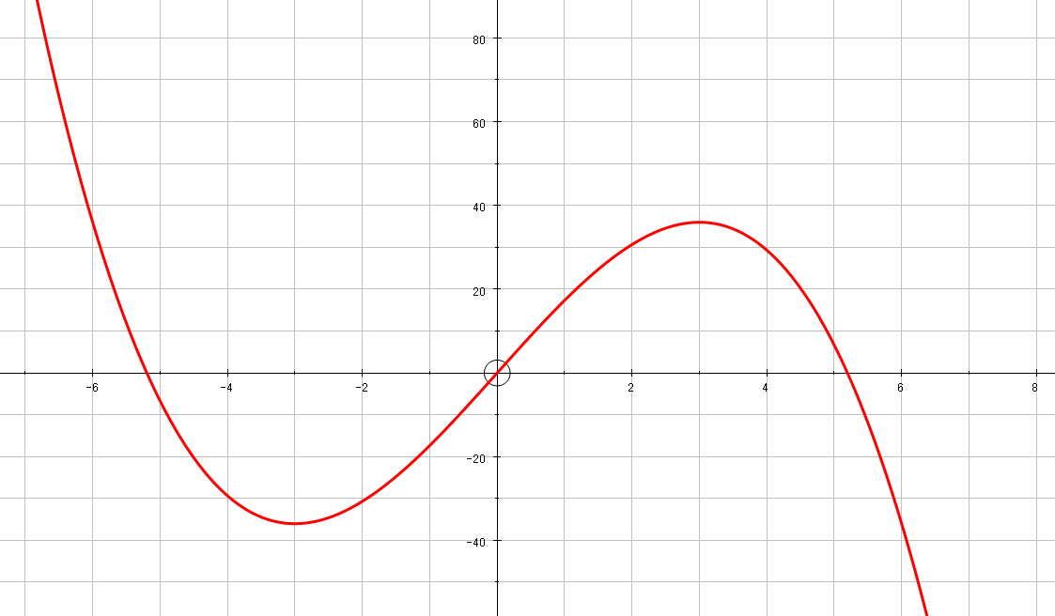
Differentiation
You need to be able to recognise practical problems that can be solved by using the idea of maxima and minima
Example Question
A large tank (shown) is to be made from 54m² of sheet metal. It has no top.
Show that the Volume of the tank will be given by:
V = 18x – ²/₃x³
V
x
x
y
x
b) Calculate the values of x that will give the largest volume possible, and what this Volume is.
The graph above shows the formula for the volume V, in terms of x (that we just worked out!)
→ So we need to calculate the value of x where the gradient is 0 – differentiate!
9C

Slide 21
Differentiation
You need to be able to recognise practical problems that can be solved by using the idea of maxima and minima
Example Question
A large tank (shown) is to be made from 54m² of sheet metal. It has no top.
Show that the Volume of the tank will be given by:
Differentiate
x
x
Set equal to 0
y
b) Calculate the values of x that will give the largest volume possible, and what this Volume is.
Rearrange
Solve
Sub the x value in
9C

Slide 22
Differentiation
You need to be able to recognise practical problems that can be solved by using the idea of maxima and minima
Example Question
A wire of length 2m is bent into the shape shown, made up of a Rectangle and a Semi-circle.
1) Find the length of the semi-circle, as this makes up part of the length.
y
a) Find an expression for y in terms of x.
x
πx 2
Rearrange to get y alone
y
Divide by 2
9C

Slide 23
Differentiation
You need to be able to recognise practical problems that can be solved by using the idea of maxima and minima
Example Question
A wire of length 2m is bent into the shape shown, made up of a Rectangle and a Semi-circle.
1) Work out the areas of the Rectangle and Semi-circle separately.
y
a) Find an expression for y in terms of x.
Rectangle
Semi Circle
x
b) Show that the Area is:
y
9C

Slide 24
Differentiation
You need to be able to recognise practical problems that can be solved by using the idea of maxima and minima
Example Question
A wire of length 2m is bent into the shape shown, made up of a Rectangle and a Semi-circle.
1) Work out the areas of the Rectangle and Semi-circle separately.
y
a) Find an expression for y in terms of x.
Rectangle
Semi Circle
x
b) Show that the Area is:
y
Replace y
Factorise
Expand
9C

Slide 25
Differentiation
You need to be able to recognise practical problems that can be solved by using the idea of maxima and minima
Example Question
A wire of length 2m is bent into the shape shown, made up of a Rectangle and a Semi-circle.
1) Use the formula we have for the Area
y
a) Find an expression for y in terms of x.
x
b) Show that the Area is:
Expand
y
Differentiate
c) Find the maximum possible Area
Set equal to 0
Factorise
Multiply by 8
Divide by (4 + π)
Divide by 2
9C

Slide 26
Summary
We have expanded our knowledge of Differentiation to include stationary points
We have looked at using maxima and minima to solve more practical problems

